Slide 1
2018-19
NEW PARENT ORIENTATION
IMMACULATE CONCEPTION SCHOOL

Slide 2
OPENING PRAYER

Slide 3
INTRODUCTIONS

Slide 4
GOALS FOR TODAY
1. Help new parents be familiar with the school
2. Provide information necessary for “day to day” life at ICS
3. Answer questions

Slide 5
OUR MISSION
At Immaculate Conception School our mission is to develop students to their full potential in body, mind, and spirit. Students are empowered to be confident Catholic leaders who are college ready and committed to making a difference.

Slide 6
ICS PHILOSOPHY
PHILOSOPHY
Immaculate Conception School is guided by the principles of Catholic education, which focus on the Gospel message, community, service, and worship.
We acknowledge the role of parents as the primary educators who serve as the first role models in the formation of their children’s spiritual and intellectual lives.
Immaculate Conception School provides opportunities for students to become faith-filled people and involved citizens. The education programs at Immaculate Conception provide students with the skills to think critically, communicate effectively, and develop as life-long learners. We strive to foster globally aware students who respond generously to the call to serve others.

Slide 7
SCHOOLWIDE LEARNING EXPECTATIONS (SLEs)
FAITH-FILLED PEOPLE
CRITICAL THINKERS
EFFECTIVE COMMUNICATORS
INVOLVED CITIZENS
LIFELONG LEARNERS

Slide 8
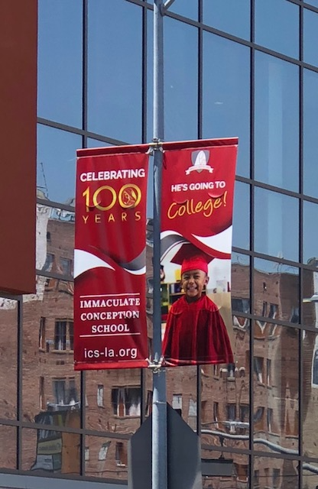

Slide 9
ICS is a Catholic PARISH school. We are part of a larger community and a ministry within our parish.

Slide 10
THINGS YOU NEED TO KNOW

Slide 11
DROP OFF & PICK UP
MORNINGS
Gates open at 7:00 a.m.
Supervision in yard at 7:15
Parking lot & lower yard at 7:30
Enter through lunch area if by car or lower gate in basketball if walking
NOT FRONT DOOR
AFTERNOONS
Parents come to yard to pick up child at dismissal
Enter yard via lunch area or Green St. gate (not front door)
Parents come in when bell rings
Students will be outside
Pick up by 3:30 or sent to daycare

Slide 12
SCHOOL HOURS & SCHEDULE
CLASSES START AT 8:00 a.m.
(Monday thru Thursday)
8:45 a.m. START on Fridays
MORNING ASSEMBLY (M, F)
WEDNESDAYS – students in gr.2-8 required to attend 7:30 a.m. Mass. FORMAL UNIFORM required on Wednesdays for everyone!
DISMISSAL is at 3:15 p.m. (M, T, Th, Fr) and 12:30 p.m. (Wednesdays)
AFTER SCHOOL CARE available daily until 6:00 p.m. (except for a few times a year)

Slide 13
COMMUNICATION
Your child will be more successful if there is STRONG 2-way communication between home & school. The teacher is committed to keeping you informed about your child’s progress. Please keep us informed of situations that may affect your child’s learning and overall well being (home situations, allergies, problems at school, etc)
GRADELINK
CLASS DOJO
AGENDAS
MONDAY NEWSLETTER
PARENT-TEACHER CONFERENCES (fall, spring, by appointment)
Notes:
We are not a dry cleaners where you can drop your child off in August and pick him/her up in June without us ever seeing you!

Slide 14
BREAKFAST & LUNCH
Federal School Lunch Program
Complete application (even if you know you don’t qualify; the data generates funding)
Breakfast is served at morning break – eat something before coming to school
Child always has option to bring lunch – no fast food; no microwave available
SNACK SALES : Friday mornings & after school

Slide 15
BIRTHDAYS
Free dress may be worn on birthday
Follow classroom guidelines—usually monthly celebration days
NO LUNCH celebrations; whatever treat you bring should be individual servings (i.e. cupcakes instead of cake)

Slide 16
FIELD TRIPS (TK-8)
FIELD TRIPS are a way to extend learning beyond our campus
NOT AN OPTIONAL school day
Parents welcome to chaperone (sometimes site limits # of adults)

Slide 17
WHAT TO DO IF YOUR CHILD IS…
ABSENT– Please call and inform the school. When your child returns, send a note to the teacher. STUDENT IS RESPONSIBLE for all work and tests missed.
LATE- Child should stop by office to check in, order lunch, etc.
LEAVING EARLY FOR AN APPOINTMENT – Parent comes to office and signs child out with office personnel (PLEASE TRY TO SCHEDULE APPOINTMENTS OUTSIDE OF SCHOOL TIME!)
HAVING AN ONGOING PROBLEM WITH ANOTHER CHILD OR SOME ASPECT OF SCHOOL…contact the teacher first, then admin if necessary

Slide 18
EMERGENCY PREPARATION at ICS
We are always trying to improve SAFETY & SECURITY for your child
  FIRE DRILLS + EARTHQUAKE DRILLS + LOCKDOWN PROCEDURES
  Classrooms equipped with EMERGENCY BACKPACKS & ESCAPE LADDERS(in TK and grades 1, 3, 4, 5, 7)
  Food and supplies on hand
  Personnel trained in CPR and First Aid
  PLEASE MAKE SURE THAT YOU HAVE SOMEONE OTHER THAN YOURSELF WHO CAN BE CONTACTED IN CASE OF EMERGENCY, OR WHOM YOU AUTHORIZE TO PICK UP YOUR CHILD IF YOU CANNOT GET HERE
  This is another reason why we need you to sign up for CLASS DOJO –it’s a way that we can communicate to everyone at once!

Slide 19
EMERGENCY PREP (continued)
Make sure your child knows your phone number and/or has it written down and in a secure place
Talk to your child about various scenarios and what you would do about them at home. Do you have a family emergency plan?

Slide 20
YOUR COMMITMENT TO YOUR CHILD’S EDUCATION AT I.C.S.
NOURISH your child’s FAITH & MORAL DEVELOPMENT
  Bring your child to Mass; use blue Sunday envelopes at least 3x/month
  PRAY with your child at home
  SPEAK about others with kindness and empathy
  HELP CHILD KNOW THAT MISTAKES ARE OKAY -- OPPORTUNITIES TO LEARN!
MAKE EDUCATION A PRIORITY
  BE on time & IN UNIFORM daily
  Make READING a part of your family culture
  Provide a routine at home and a quiet space for homework
  Establish and maintain strong home-school communication
  Teach your child to be independent and responsible

Slide 21
YOUR COMMITMENT…
FINANCIAL RESPONSIBILITIES--
SMART payments on time—don’t fall behind!
service hours (20 + shift at Fiesta)
fundraisers (RAFFLE, CANDY SALE, MOTHER’S DAY)
GET INVOLVED! Your positive presence at school will impact your child’s success!
volunteer if you have time
join Parent Planning Committee
it takes ALL of us to make things happen

Slide 22
OUR COMMITMENT TO YOU
We will nurture your child in a faith-filled environment
We will be well-prepared and GIVE OUR BEST daily
We will return phone calls and email communications in a 24 hour period
We will be welcoming and approachable

Slide 23
QUESTIONS & COMMENTS

